Slide 1
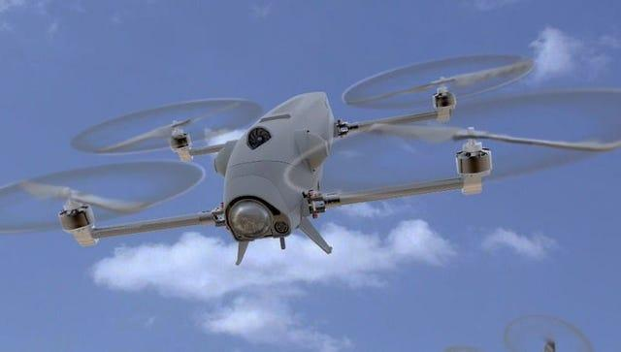
Robust tracking control for a quadrotor subjected to disturbances using new hyperplane-based fast Terminal Sliding Mode
Mariam JANBEIN – Adel KANSO
Directed By : Imtiaz Ur Rehman
Based on PLOS ONE Research Paper and Lab Work Implementation
Moussa Labbadi, Jamshed Iqbal, Mohamed Djemai, Yassine Boukal, Yassine Bouteraa

Slide 2
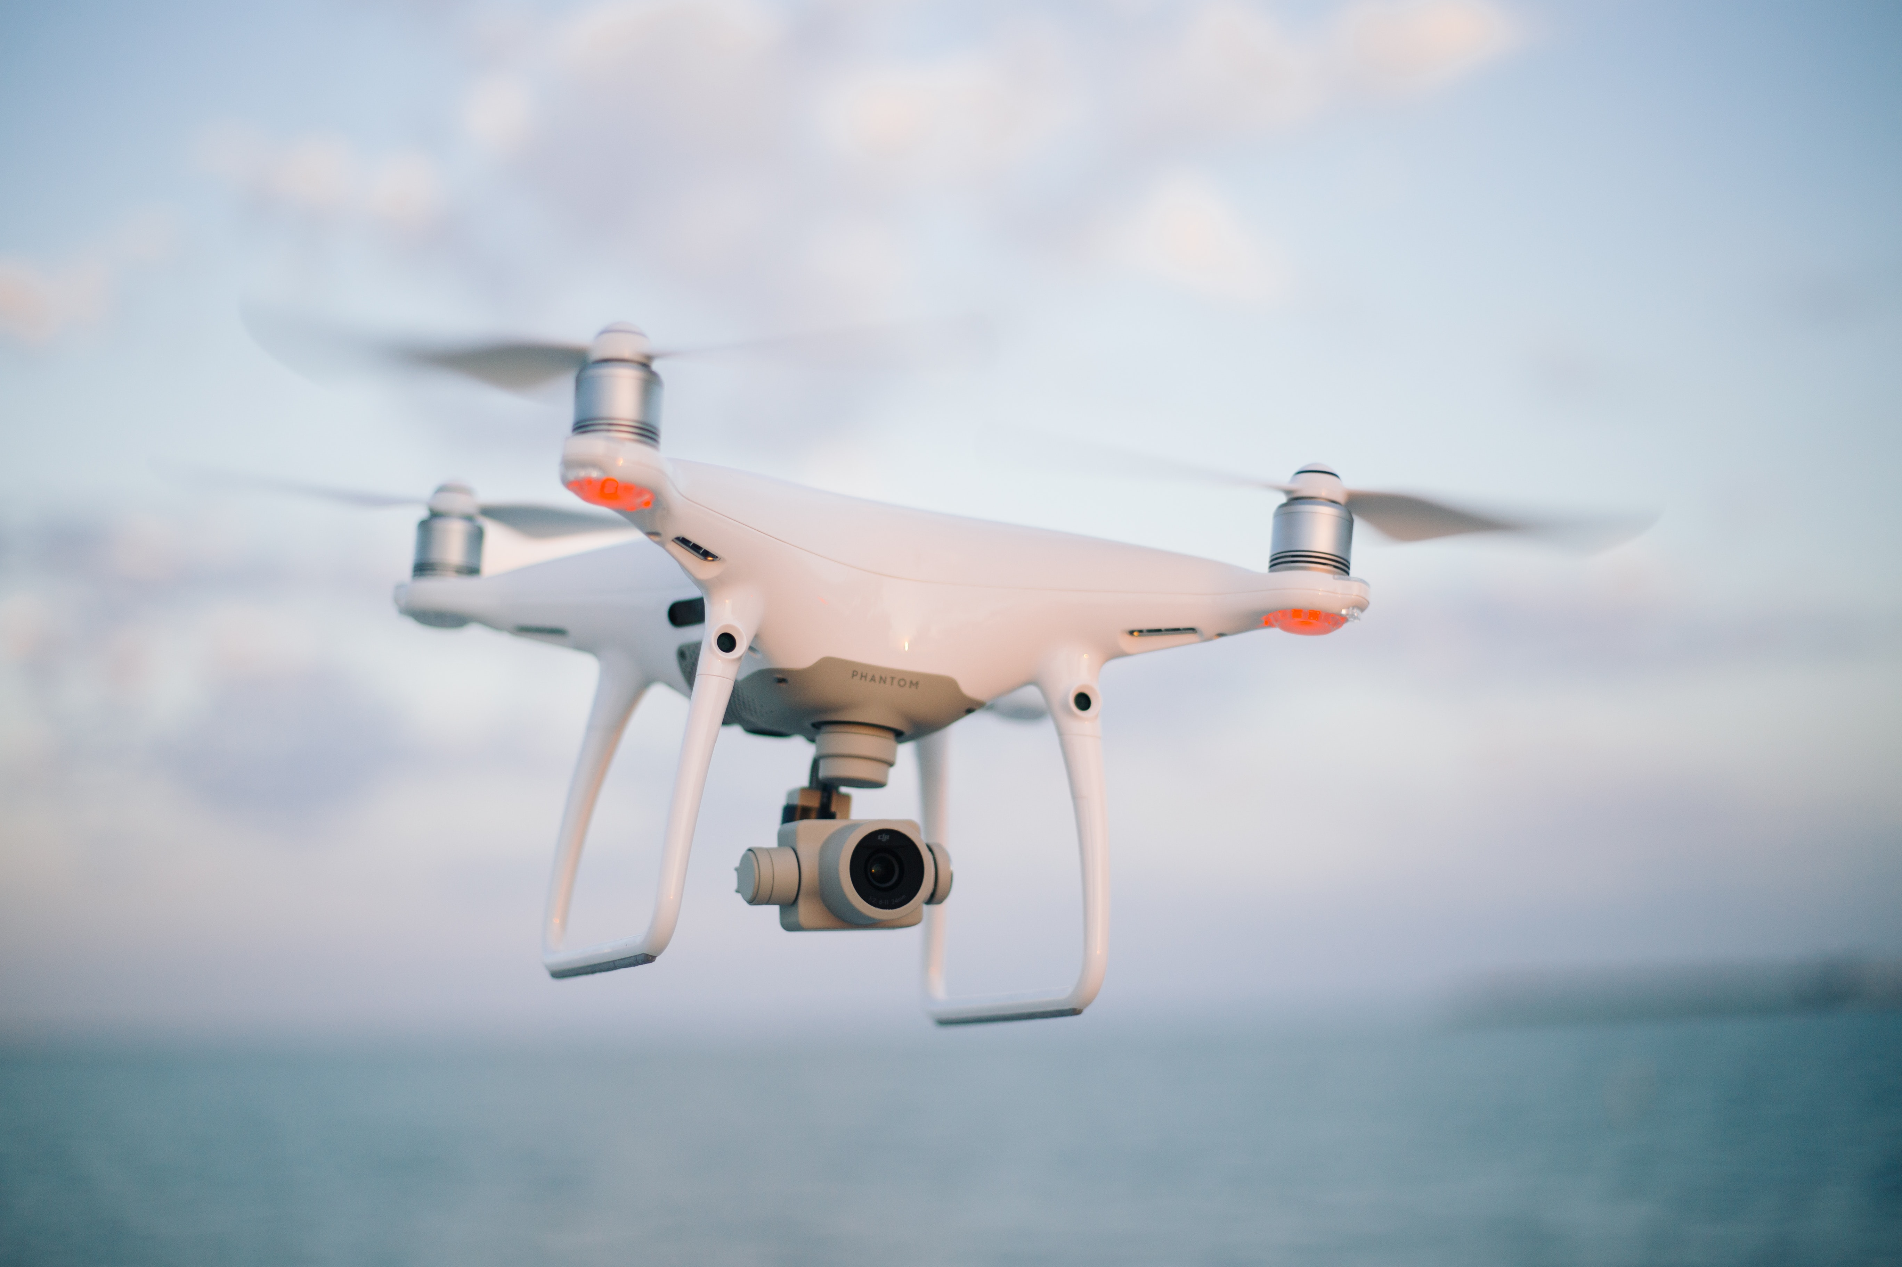
Introduction
The quadrotor is nonlinear, underactuated and subject to disturbances. Sliding Mode Control (SMC) is robust but causes chattering. This paper builds a new controller that combines integral terminal sliding mode and nonsingular terminal sliding mode into a hyperplane sliding manifold, yielding finite-time convergence and smoother inputs.
Motivation : Robust tracking under disturbances
Challenges:
Nonlinearity, underactuation, chattering
Proposed approach:
INH-SMC combining ITSM + NTSM

Slide 3
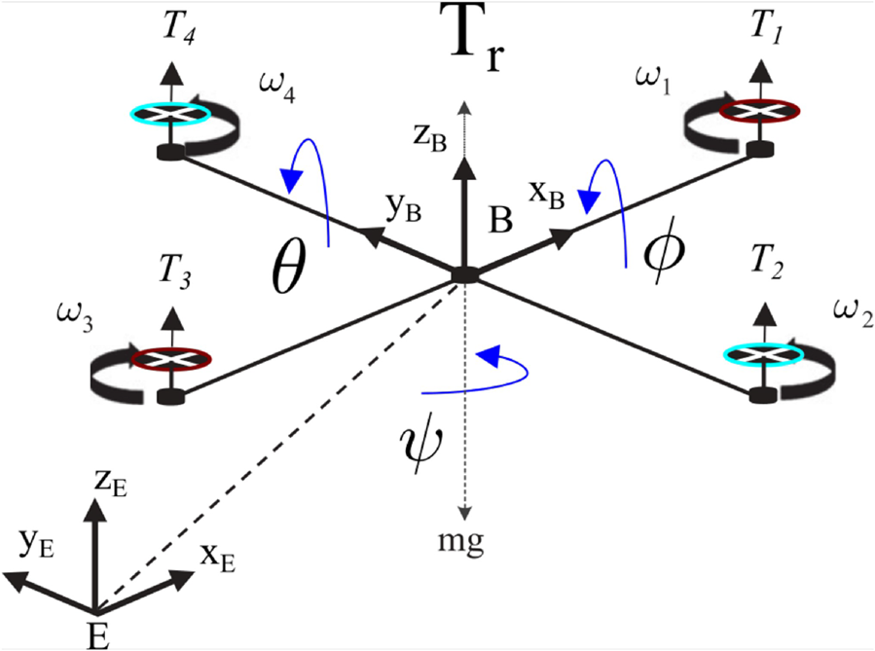
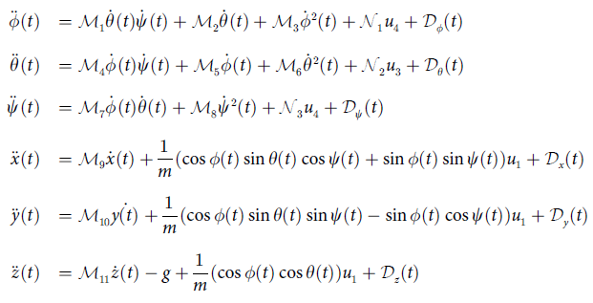
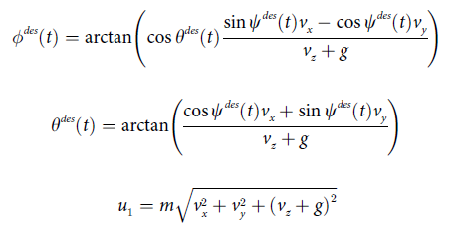
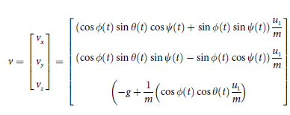
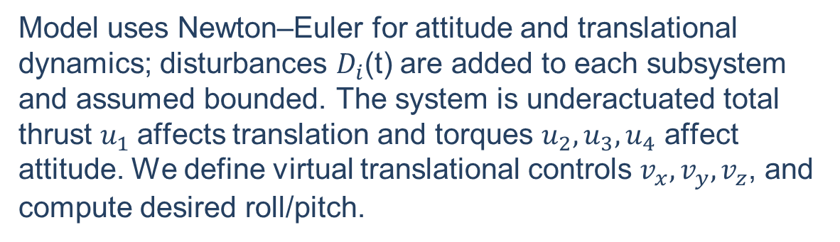
Mathematical model
Model uses Newton–Euler for attitude and translational dynamics; disturbances $D_{i}$(t) are added to each subsystem and assumed bounded. The system is underactuated total thrust $u_{1}$affects translation and torques $u_{2},u_{3},u_{4}$​ affect attitude. We define virtual translational controls $v_{x},v_{y},v_{z}$​, and compute desired roll/pitch.
Attitude (roll, pitch, yaw), Translational (x,y,z):
Constants Mi,Ni are (functions of inertia, drag, rotor effects)
Lift and tilting angles:
Virtual translational inputs:

Slide 4
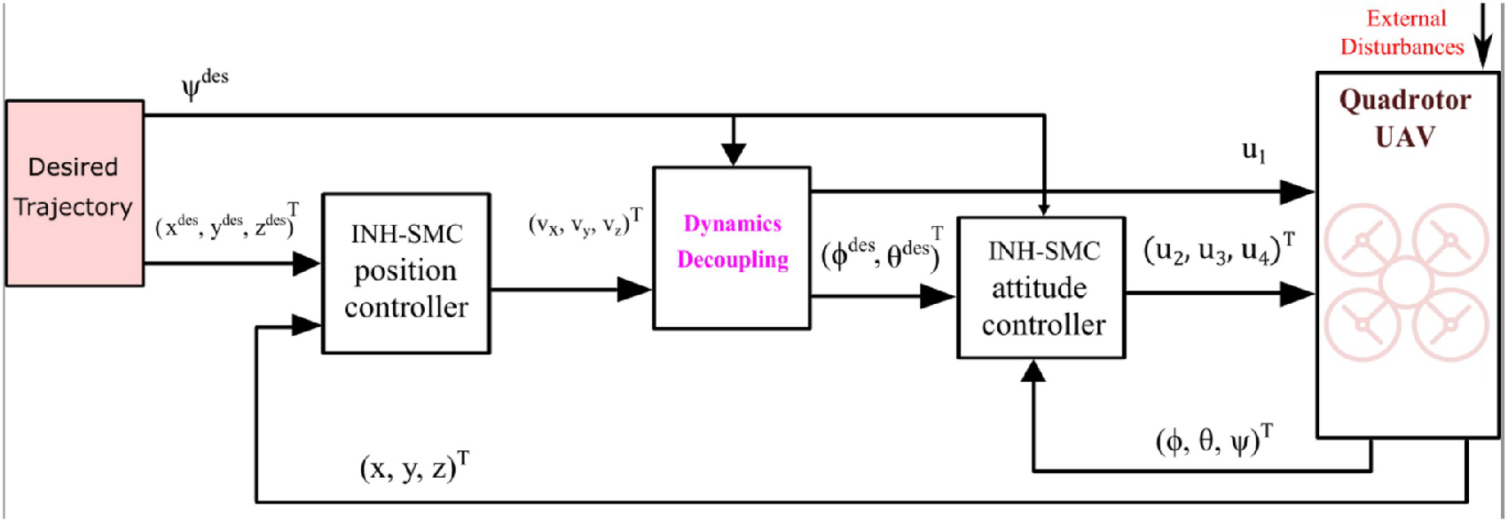



Control Design
Objective :Make the quadrotor track a reference trajectory despite bounded disturbances, with finite-time convergence of tracking errors to zero.
Control System Structure
Integral Terminal Sliding Mode (ITSM)
Nonsingular Terminal Sliding Mode (NTSM)
Hyperplane-based Approach
Ensures robustness against disturbances
Achieves fast convergence
Combines ITSM + NTSM for position & attitude
Avoids singularities in traditional TSM
Reduces chattering in control signals
Minimizes steady-state errors
Guarantees finite-time convergence

Slide 5
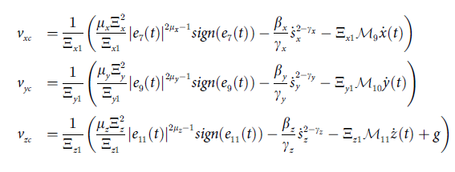
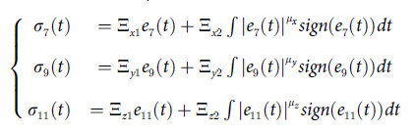
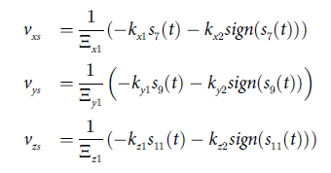
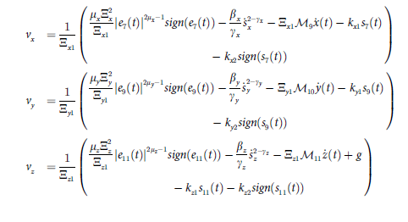
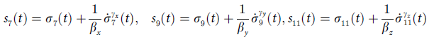
Control design-position loop
Step A: Define tracking errors (position):
The controller is composed of two control laws: one is a continuous control law, while the other is a discontinuous control law.
Continuous control law for position loop:
Using the double time derivative of the tracking errors, the continuous control laws for the position of a quadrotor are given by:
Step B: Build ITSM sliding variables with positive gains:
Reaching control law for position loop:
A switching law is added to the equivalent
law to increase efficiency against model uncertainty:
Step C: Augment with NTSM (hyperplane) to obtain final sliding variable:
The full control input is :

Slide 6
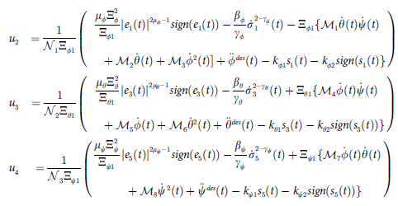
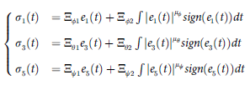
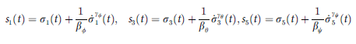
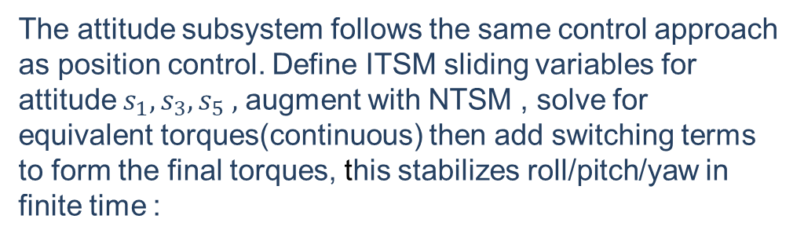
Control design-attitude loop
Step A Define attitude errors :
The attitude subsystem follows the same control approach as position control. Define ITSM sliding variables for attitude $s_{1},s_{3},s_{5} ,$ augment with NTSM , solve for equivalent torques(continuous) then add switching terms to form the final torques, this stabilizes roll/pitch/yaw in finite time :
Step B ITSM (attitude):
Step C Hyperplane (NTSM augmentation):
That continuous term cancels model dynamics on the manifold and avoids high-frequency switching, reducing chattering. The discontinuous switching law is added to ensure robustness against disturbances.

Slide 7
Results

Slide 8
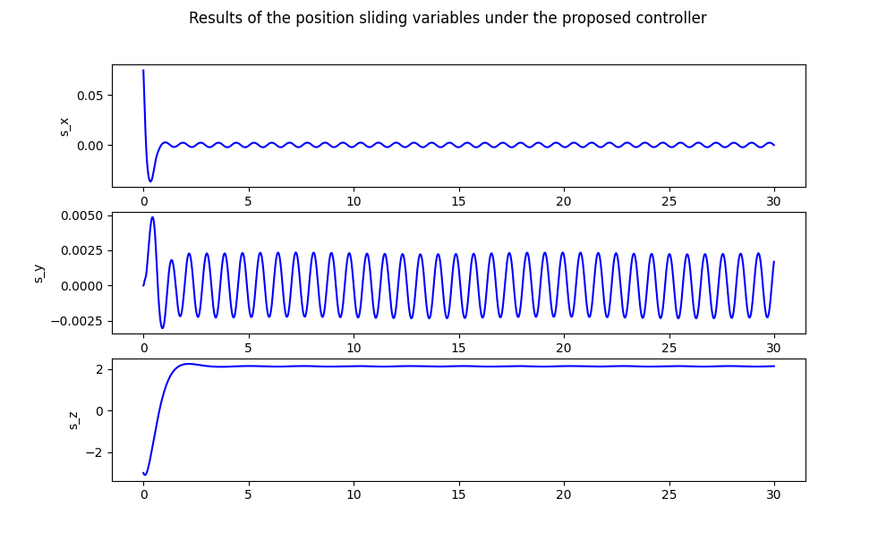
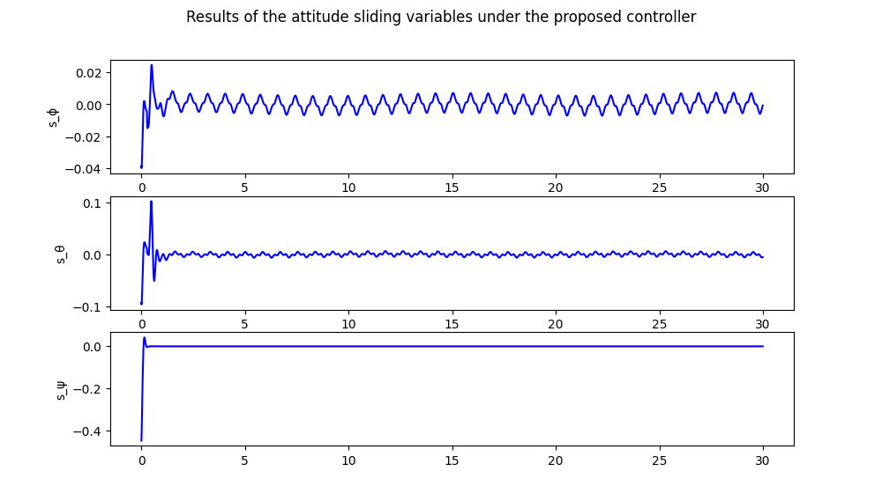
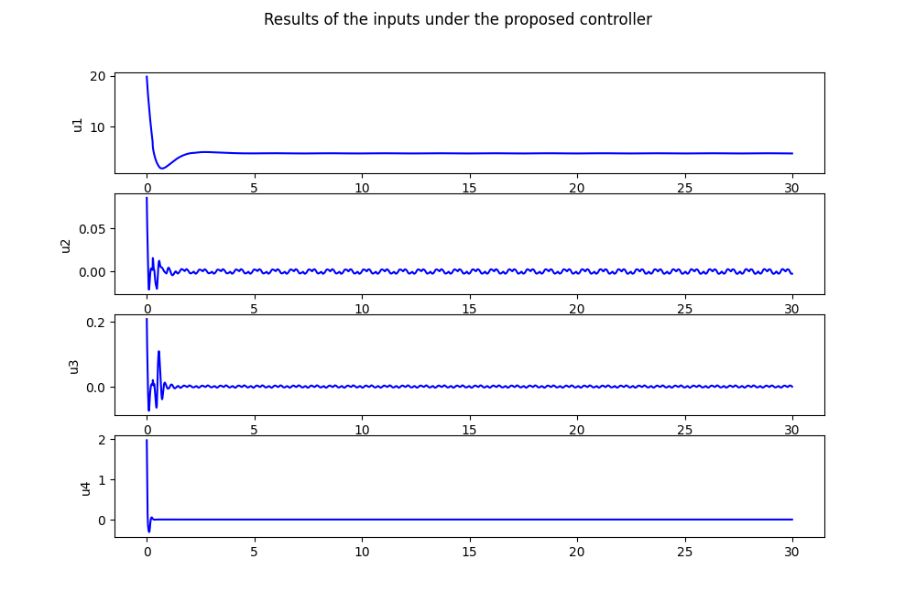
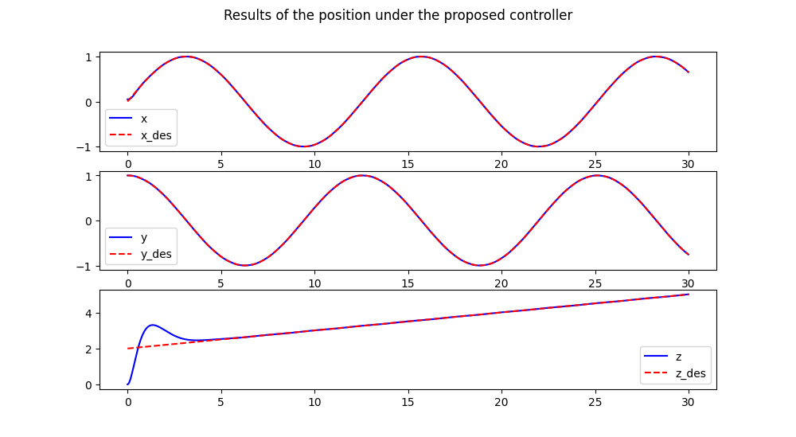
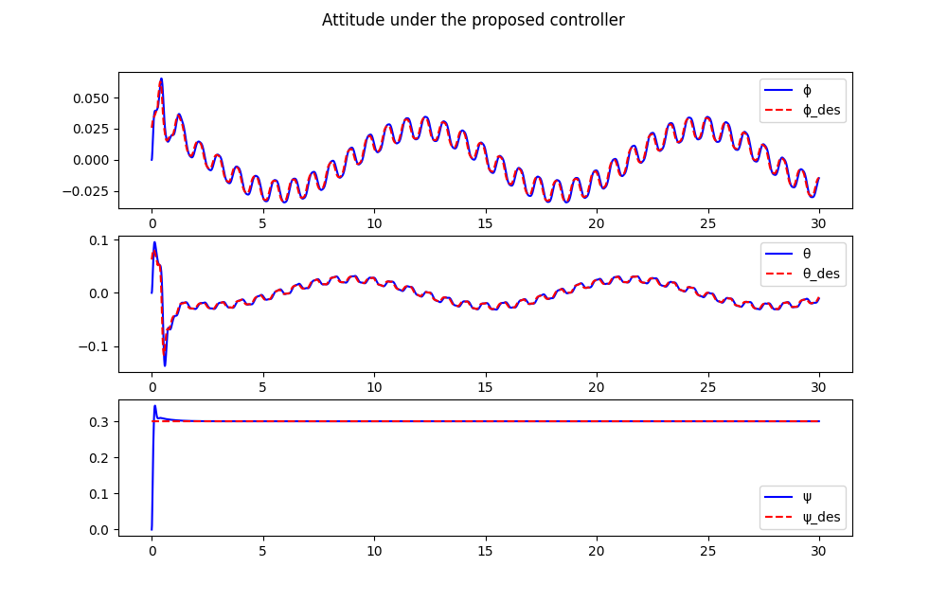
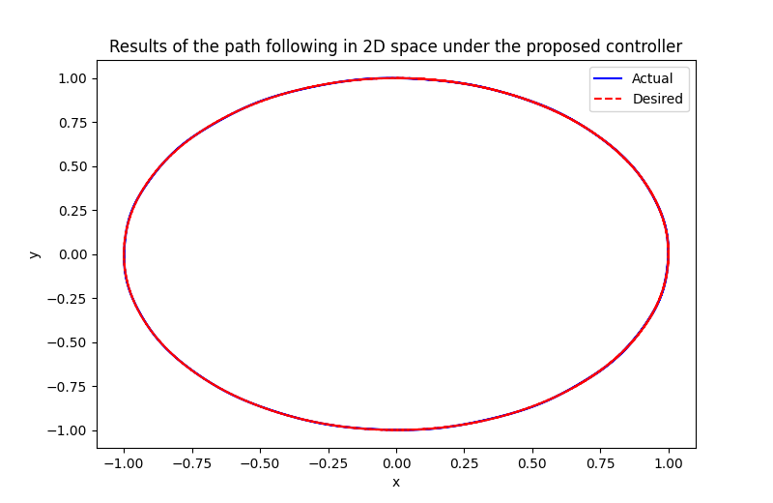
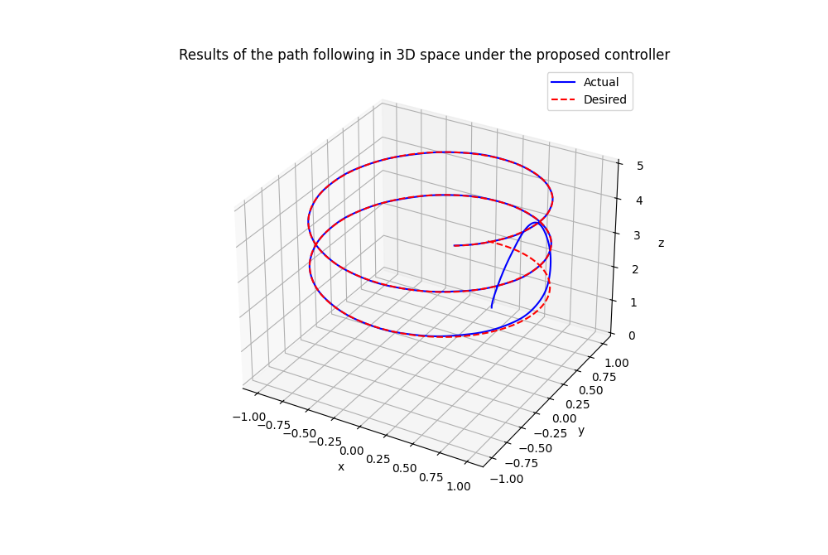
Spiral Trajectory Simulation (No Disturbance) Results

Slide 9
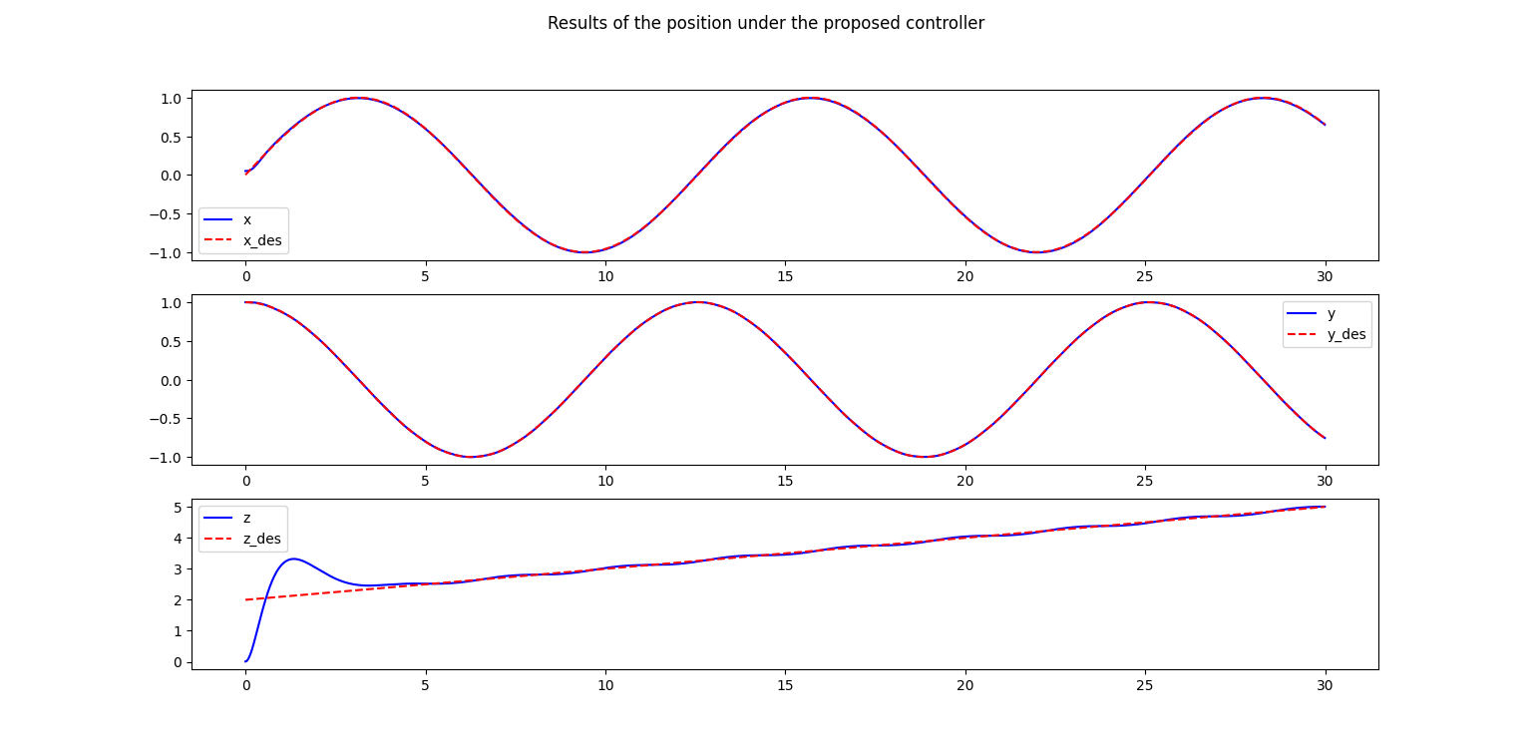
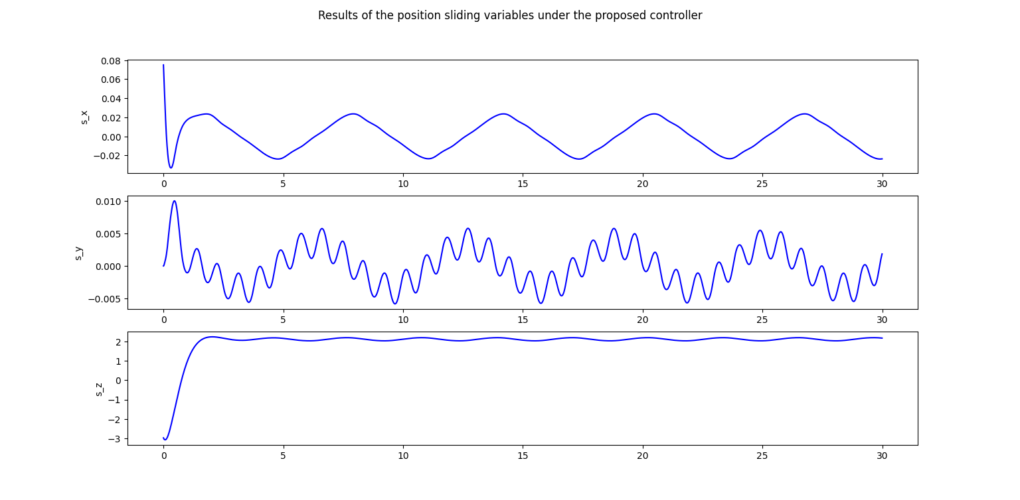
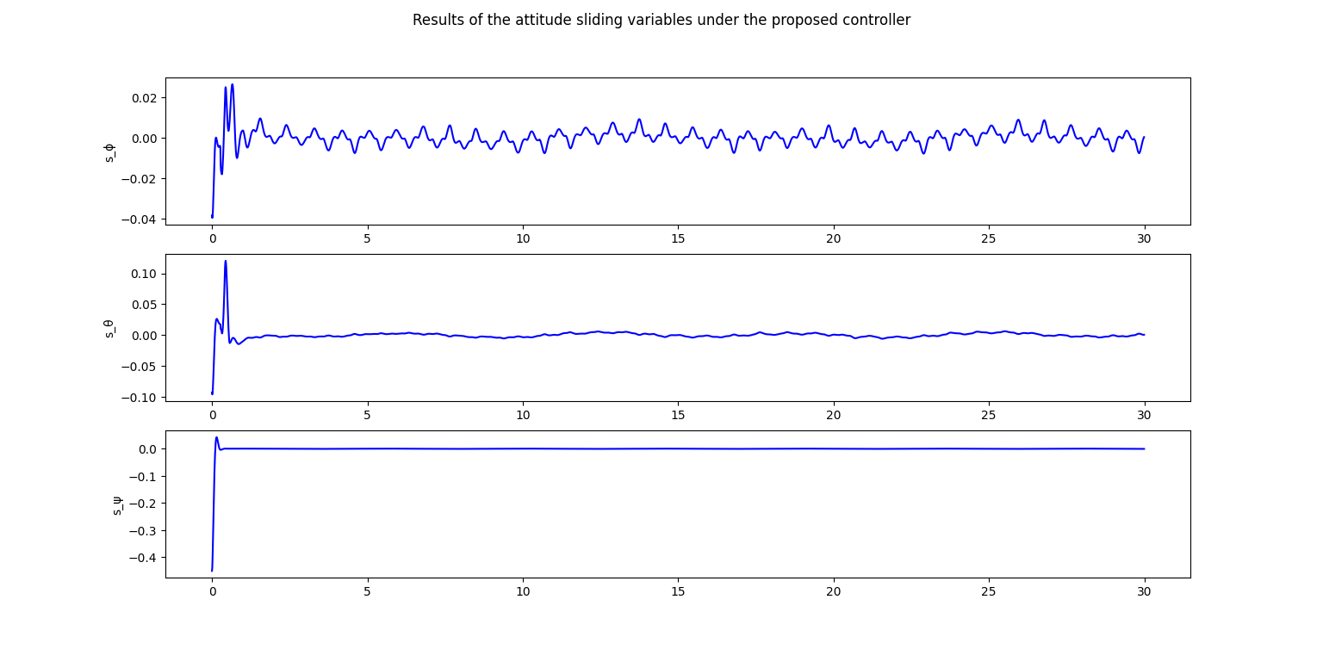
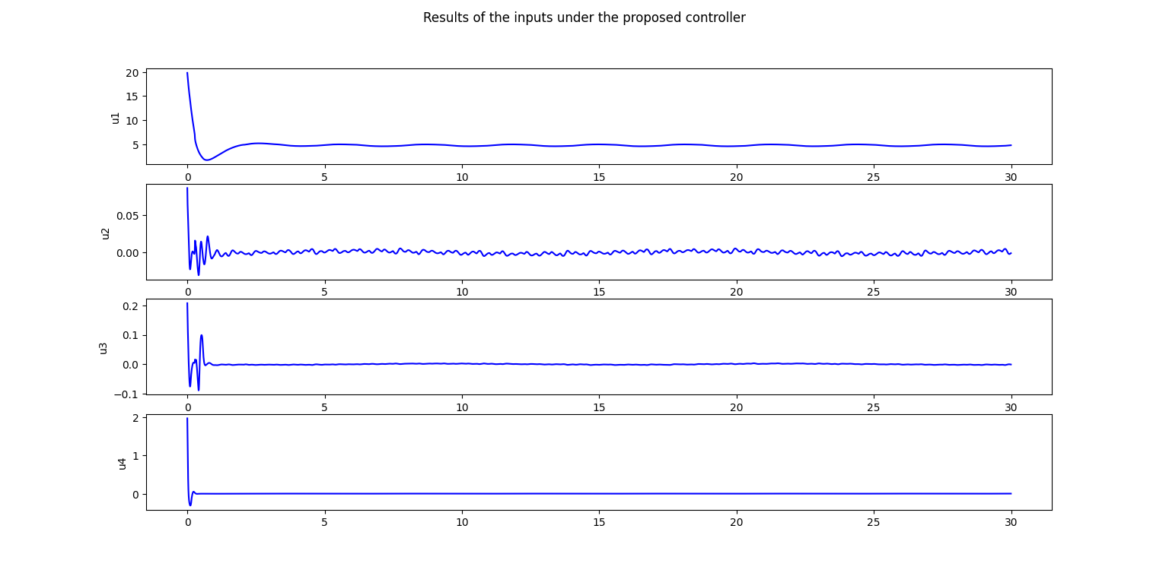
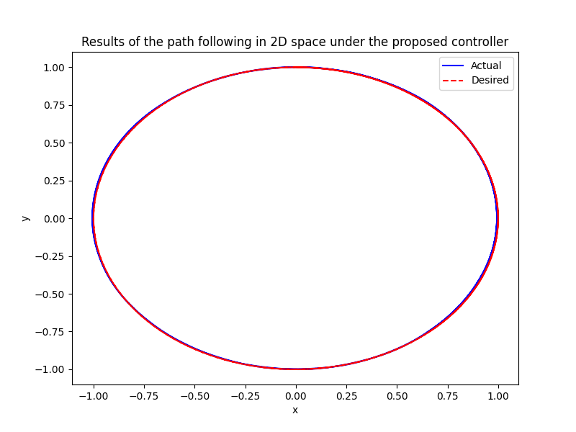
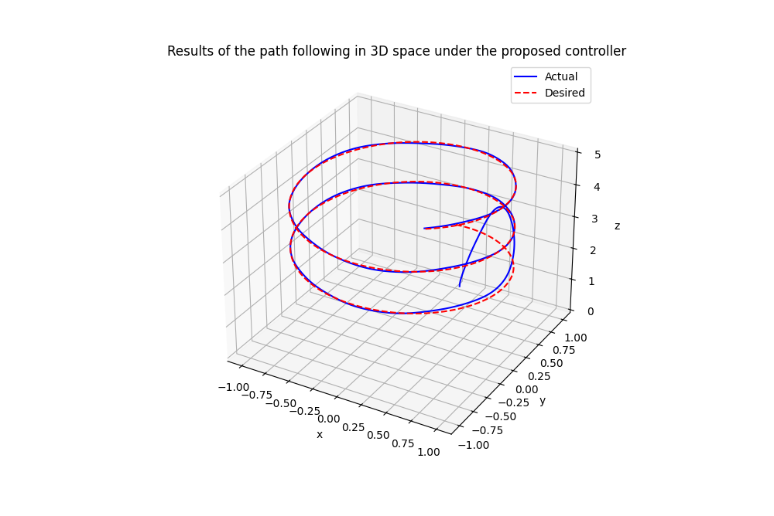
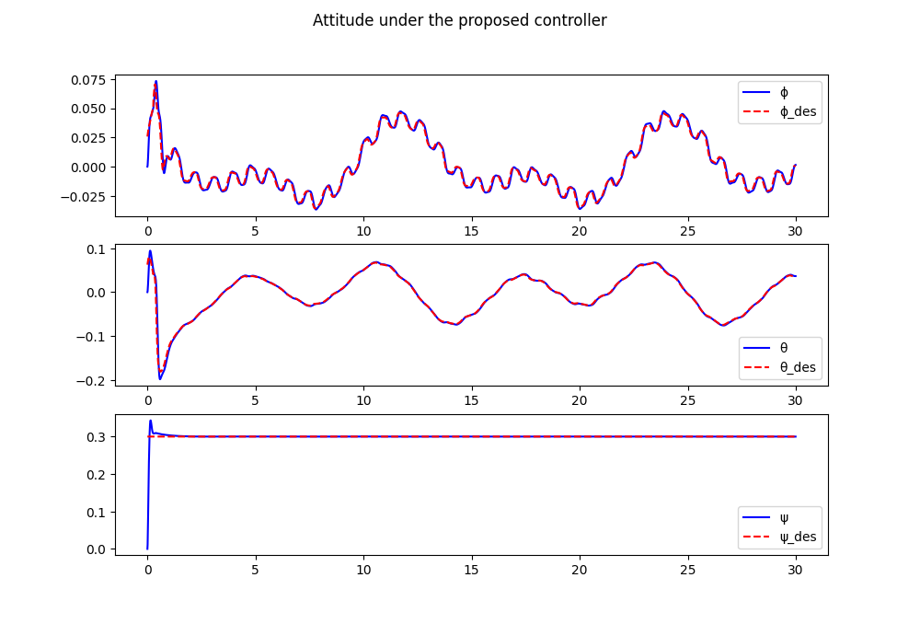
Spiral Trajectory Simulation (Disturbance eq.44.) Results

Slide 10
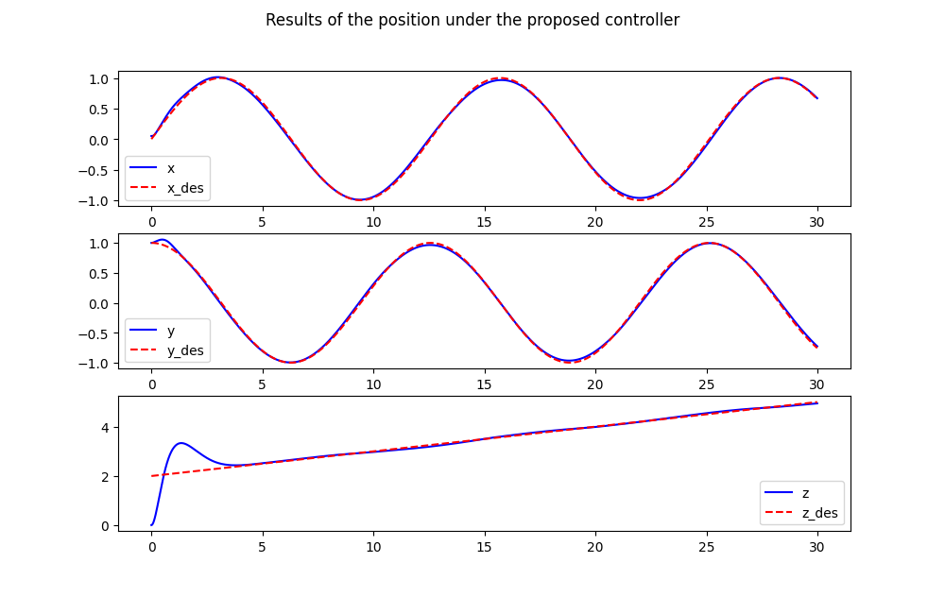
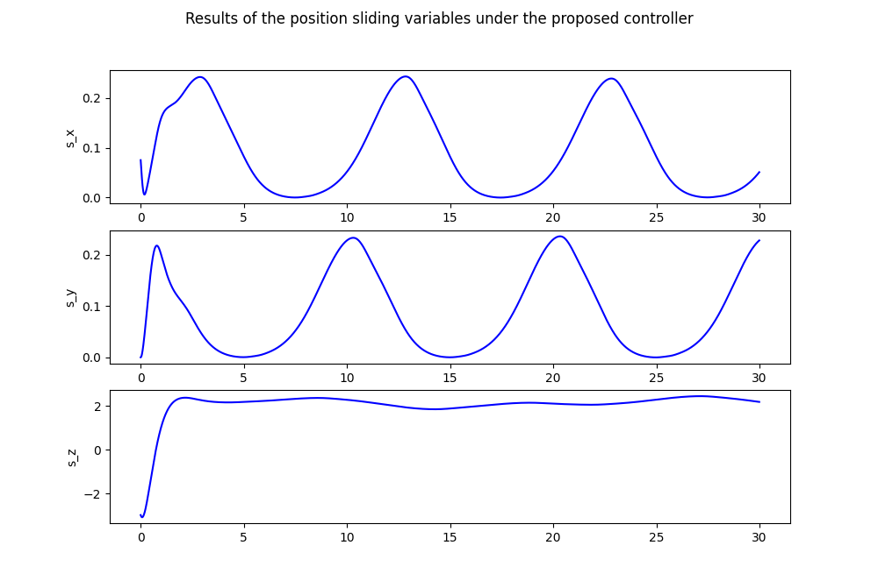
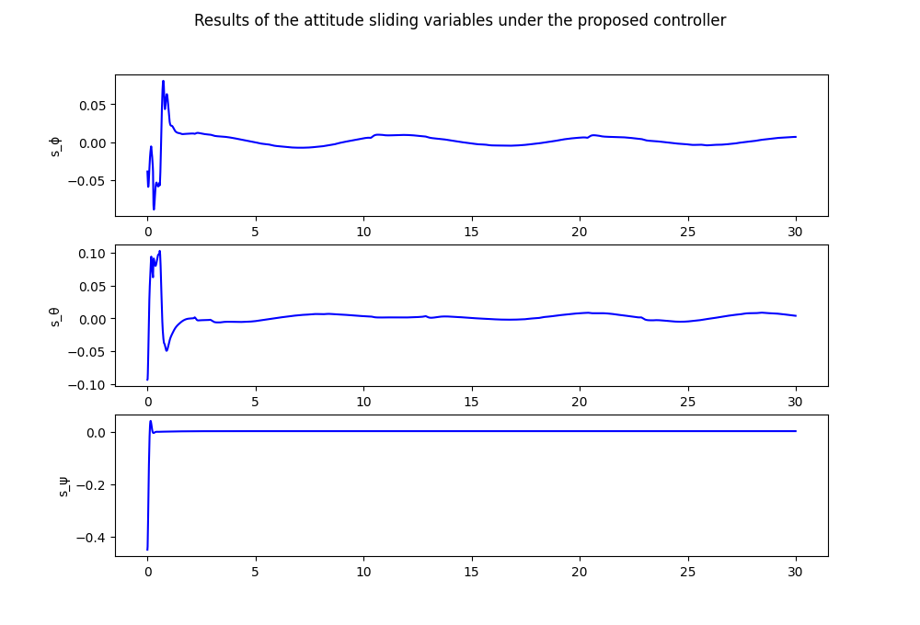
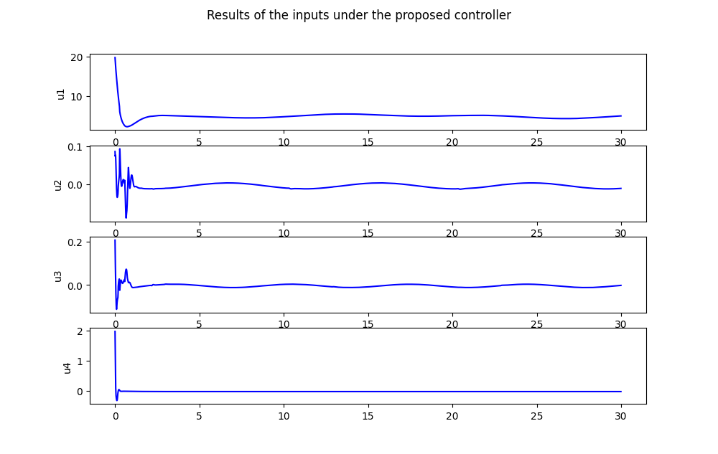
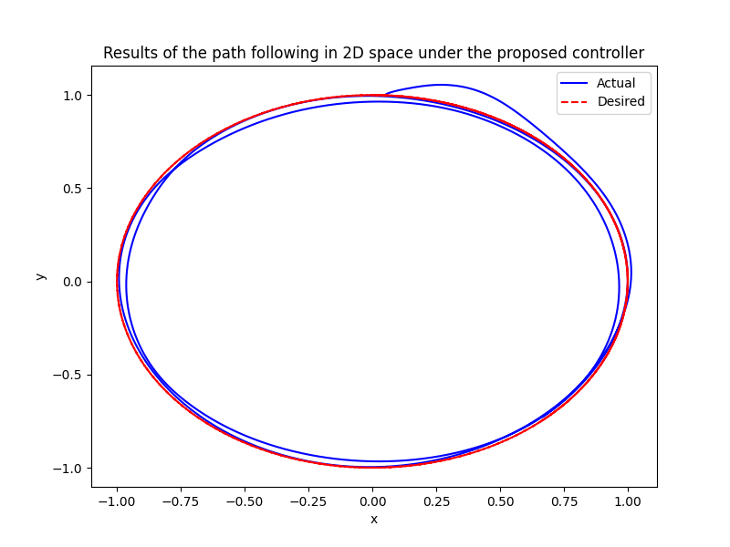
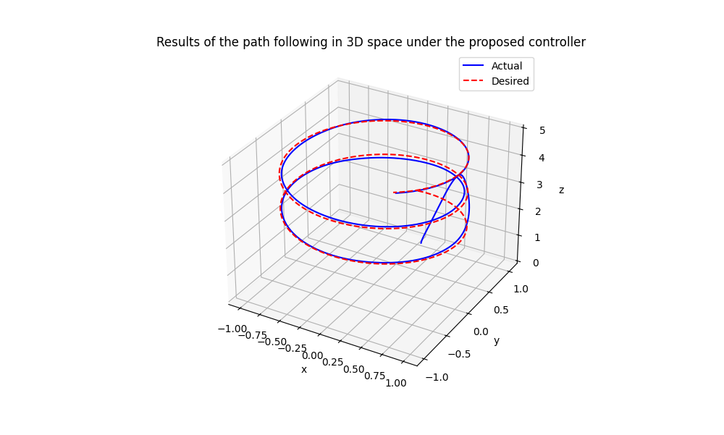
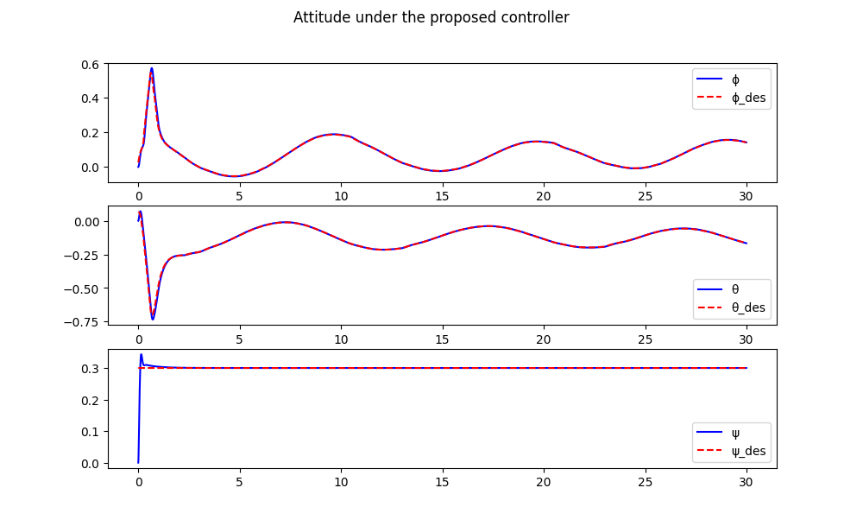
Spiral Trajectory Simulation (Disturbance eq.43.) Results

Slide 11
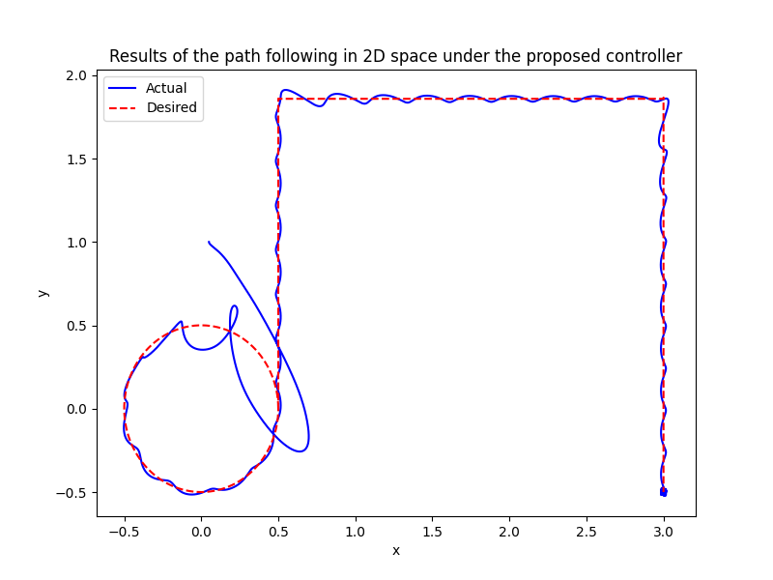
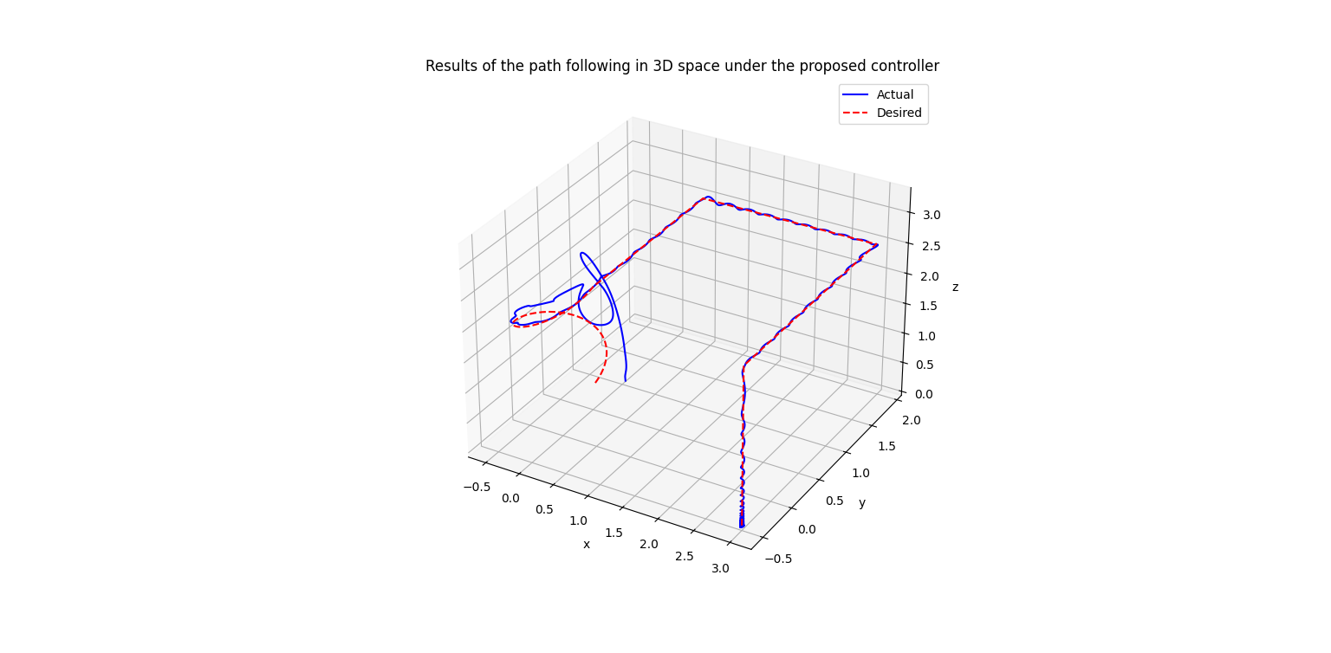
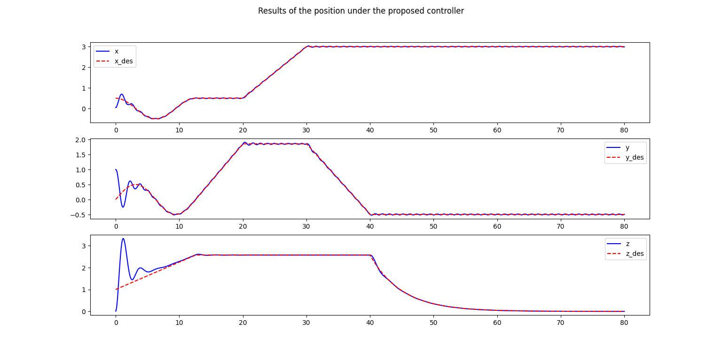
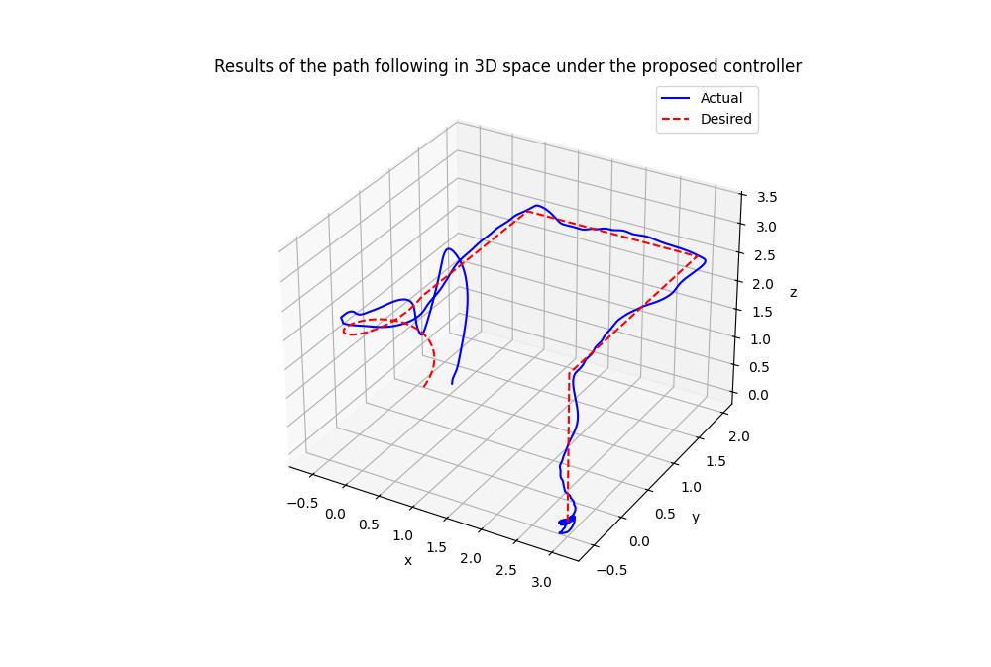
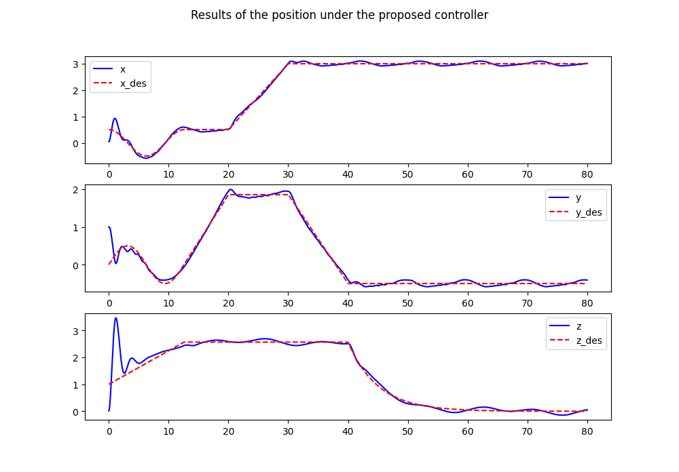
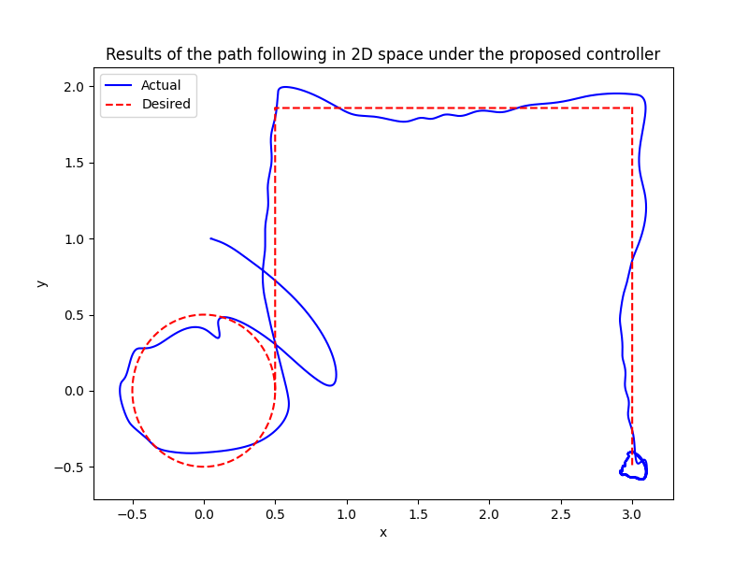
Loop and corner Trajectory Simulation Results
No Disturbances :
With Disturbances given in the paper :

Slide 12
Hardware

Slide 13

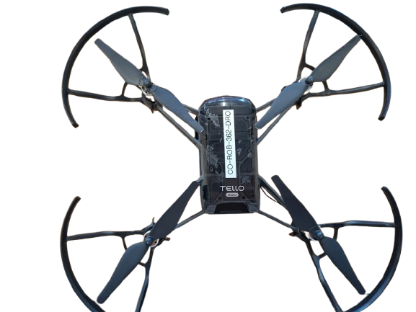
Implementation
Quadrotor Hardware Structure
Lightweight plastic body designed for indoor/outdoor flight.
Four arms supporting motors and propellers.
Four small propellers (2 clockwise, 2 counter-clockwise) attached to each motor
Removable Li-Po (Lithium Polymer) battery powering all electronics and motors
Wireless Link Uses 2.4 GHz Wi-Fi (802.11n) for control commands and video
Multi-color LED gives visual feedback on power, connection, and flight state

Slide 14
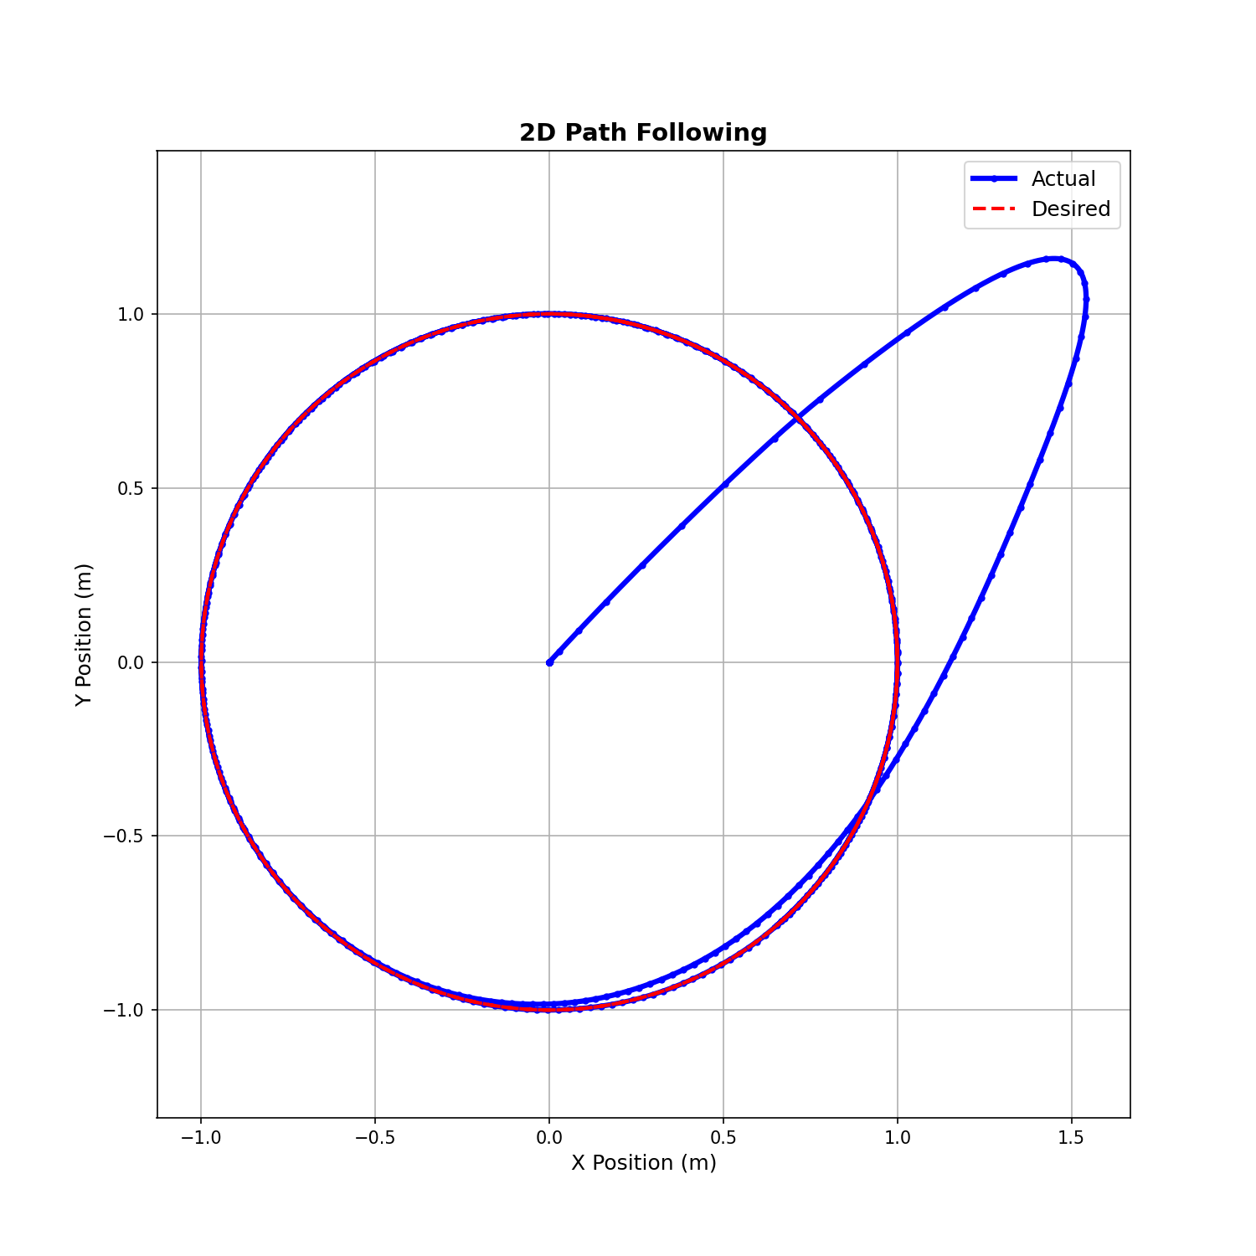
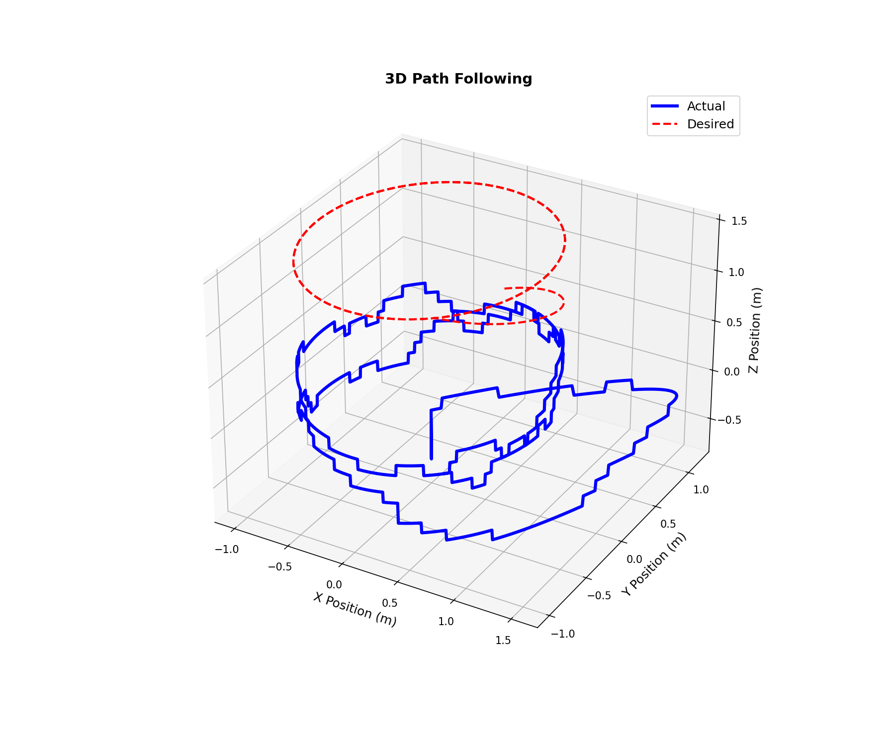
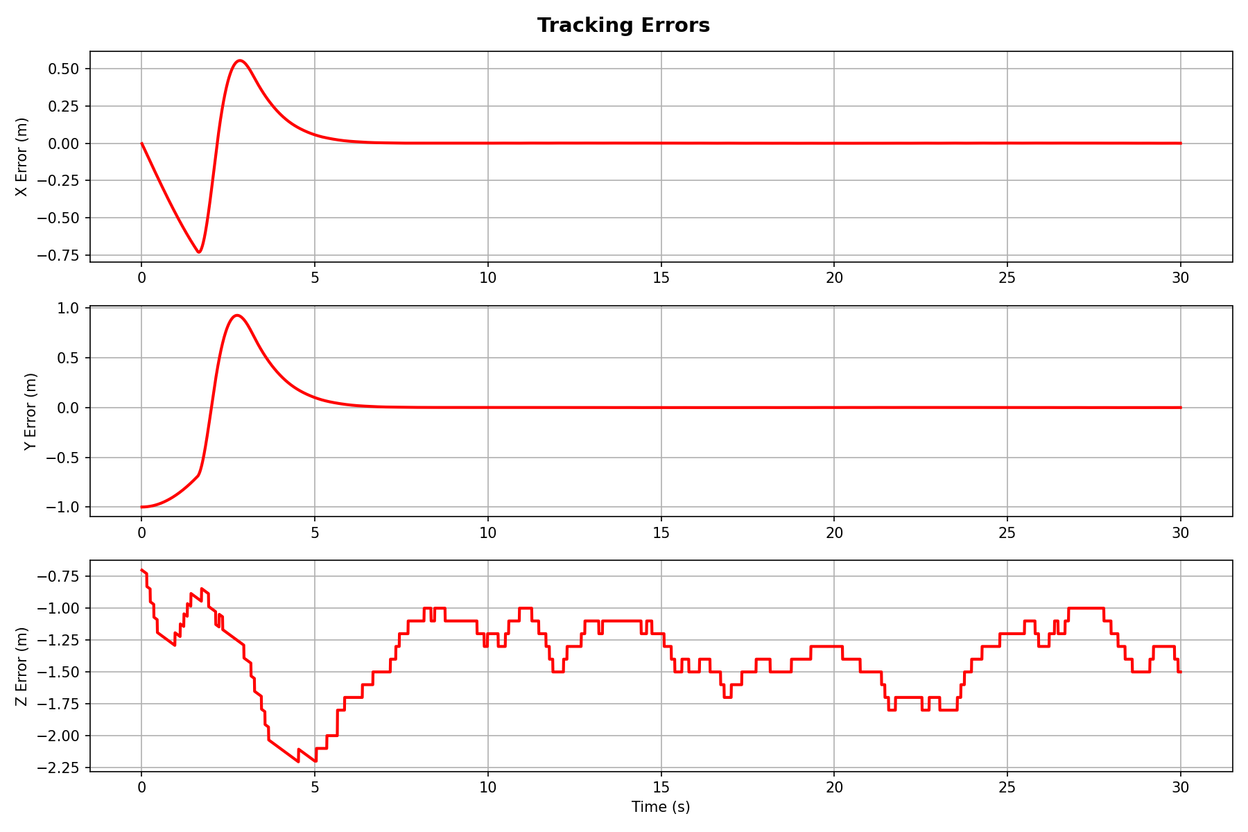
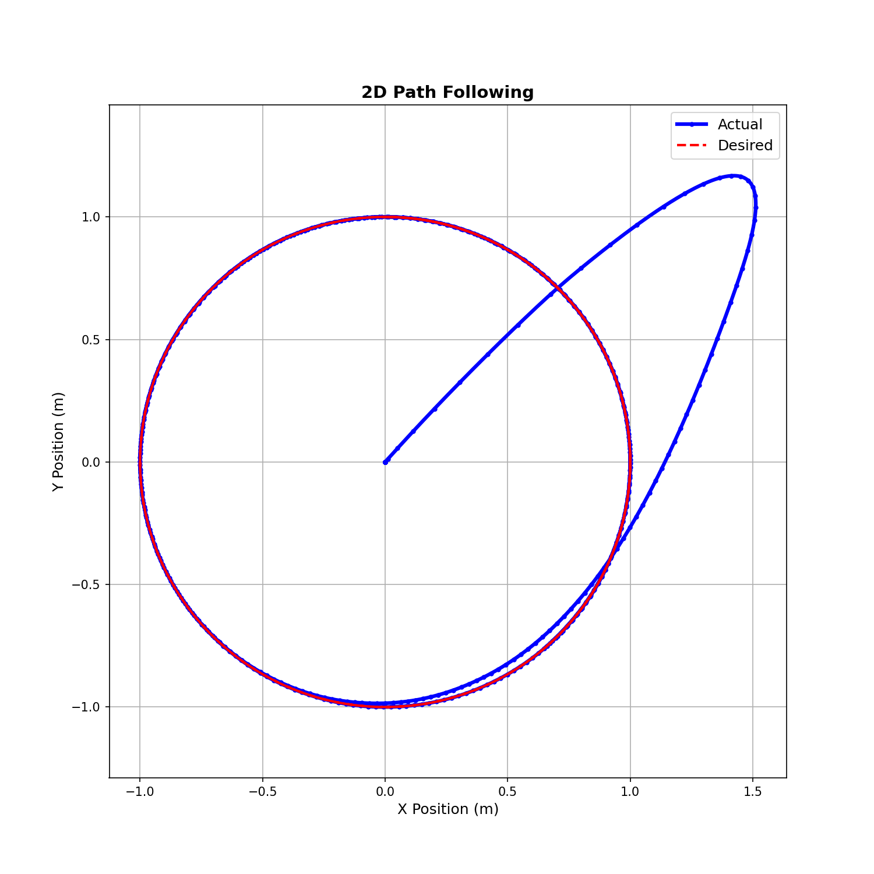
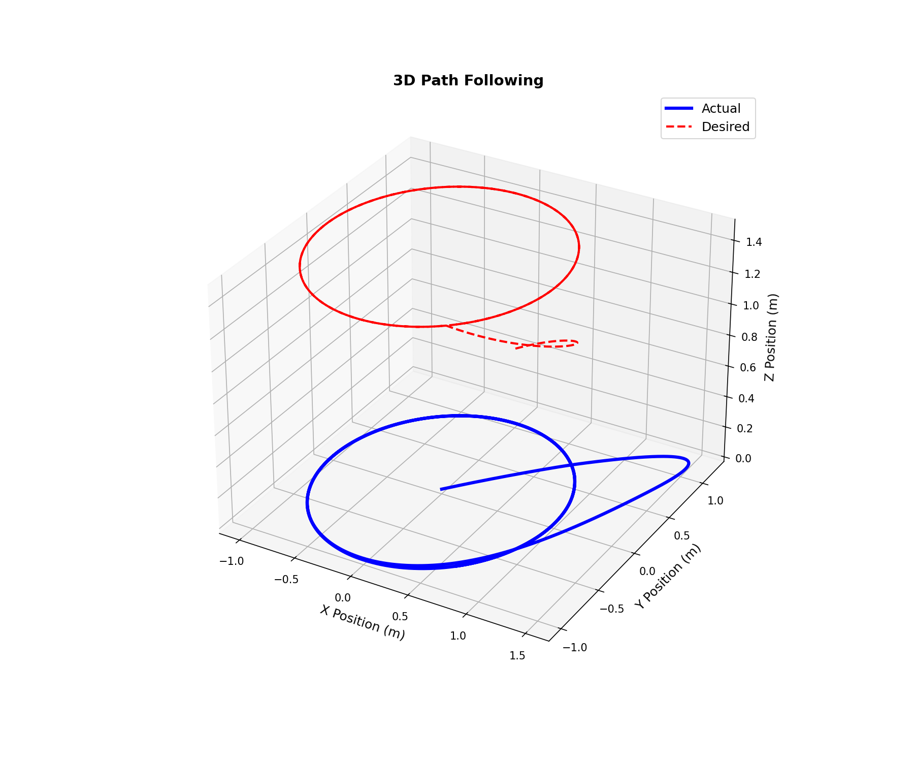

Results
First Attempt:
Second Attempt:

Slide 15

Conclusion & Future Work
Conclusion
Future Work
Faster state convergence compared to traditional SMC methods
The sliding surface helps the drone follow the desired path
In simulation, the system reaches the sliding surface quickly.
Complete the Experimental Validation
Investigate Fractional-Order Control for Performance Improvement

